Slide 1
“Socio-Cultural Capacity Building” A Window to Future Integrated Management

Slide 2
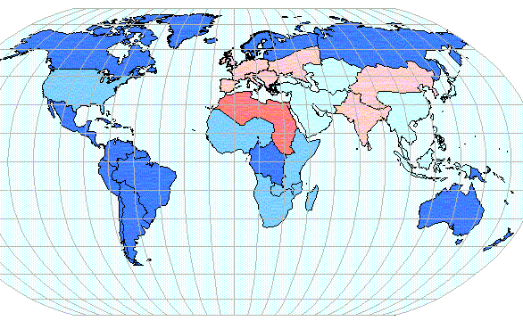
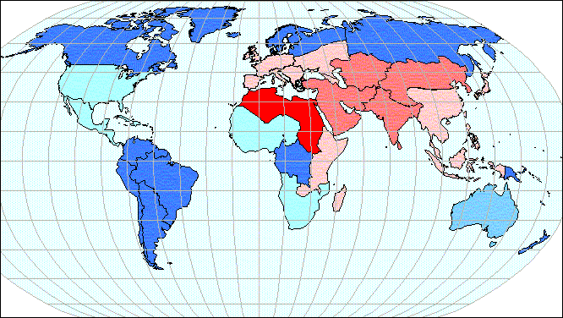
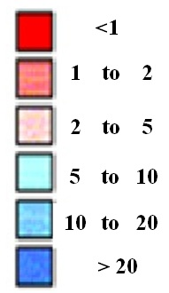
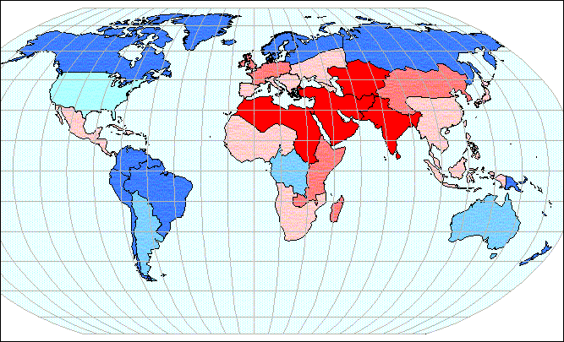
Water and Energy have become a global concern in almost all over the world in recent decades. The limitation of the resources, being nonrenewable and non-optimal consumptions changes this concern into more complicated challenges which in order to be solved need different approaches.
1950
1995
2025
Trend of water crisis developing
1

Slide 3
If we consider the public and the people of a society as one of the most important factors in the field of water and energy, consumption and management, then the Anthropology as the study of human being will be bolded. it can be considered as the main approach in purpose of studying the beliefs, cultures, insights and consumption models in a society. The outcomes of such a study can help the decision makers to concern an analysis of the actors which will be a base for managing the Water & Energy recourses in a more sustainable manner
2

Slide 4
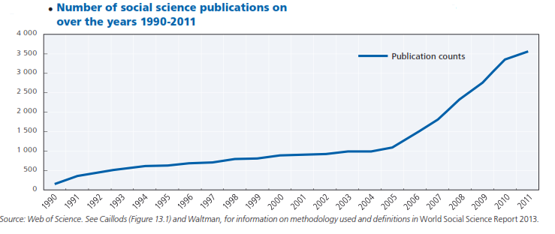
“capacity building” is a term used frequently in recent years in purpose of emphasizing on the role of public domain in order to achieve sustainable development in the fields such as water and energy.
3

Slide 5
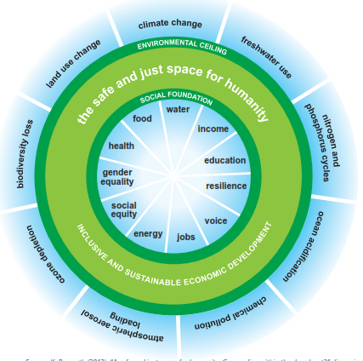
Capacity building is the process by which individuals, groups, organizations, institutions and societies increase their ability to a) perform core functions, solve problems, define and achieve objectives and b) understand and deal with their development needs in a broad context and in a sustainable manner. Over the years, capacity building has changed its direction from focusing on concerning individual training to a more complex system .
4

Slide 6
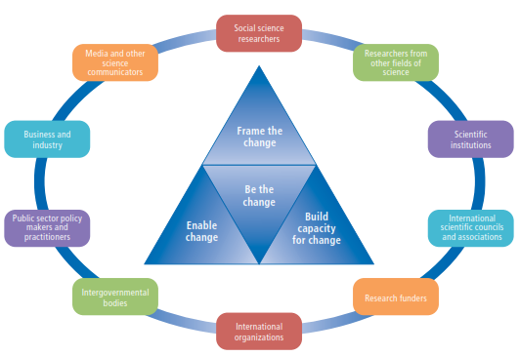
Regarding the new approaches of Iranian water managers in order to shift from structural scales to non-structural management, it is important and useful to hold discussions among managers and international experts about new approaches especially the anthropological notions.
5

Slide 7
According to this viewpoint and regarding to be at the final year of Education for Sustainable Development decade, and also the statement of the world water day (2014) called “Water and Energy”, the proposed symposium will focus on reviewing and explaining the problems and challenges around Water & Energy in Iran from an anthropological viewpoint. It will be tried to explain and review the modules and global successful experiments with the aim of solving the conflicts .
International symposium on
“The Anthropology of Water & Energy in the Context of Iranian Society for Socio-Cultural Capacity Building”
6

Slide 8
Objectives of the symposium:
• Reviewing the Water and Energy challenges from the anthropological view
• Presenting the models, structures and practices to
achieve possible solutions for resolving the issue.
• Discussing the ways of defining and using the anthropological studies for Water and Energy challenges
• finding diverse ways in order to solve the challenges and move towards sustainability
7

Slide 9
Schedule
The symposium will be held during two days.
The main programs of the symposium will be opening ceremony, talks , three professional sessions and presentation of the final statement.
Date
17, 18 May 2015
Location
Tubingen, Germany
8

Slide 10
Thank you!
and It’s not the end…
9

